Slide 1
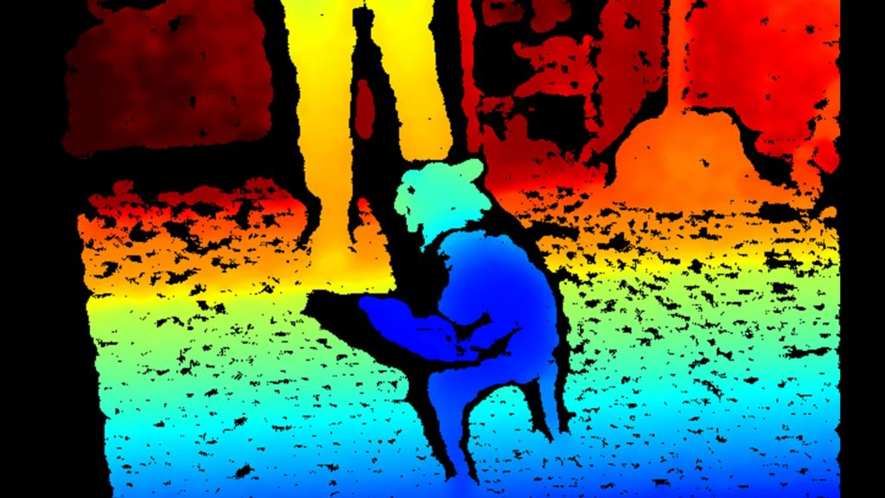
NN basics

Slide 2
References
http://cs231n.stanford.edu/index.html
http://www.cs.cornell.edu/courses/cs5670/2019sp/lectures/lectures.html
http://www.cs.cmu.edu/~16385/

Slide 3
What is a neural network?
The object recognition challenge
Neural networks history.

Slide 4
What is a neural network
Artificial neural networks (ANN) are computing systems vaguely inspired by the biological neural networks that constitute animal brains. Such systems "learn" to perform tasks by considering examples, generally without being programmed with task-specific rules.
[Wikipedia]

Slide 5
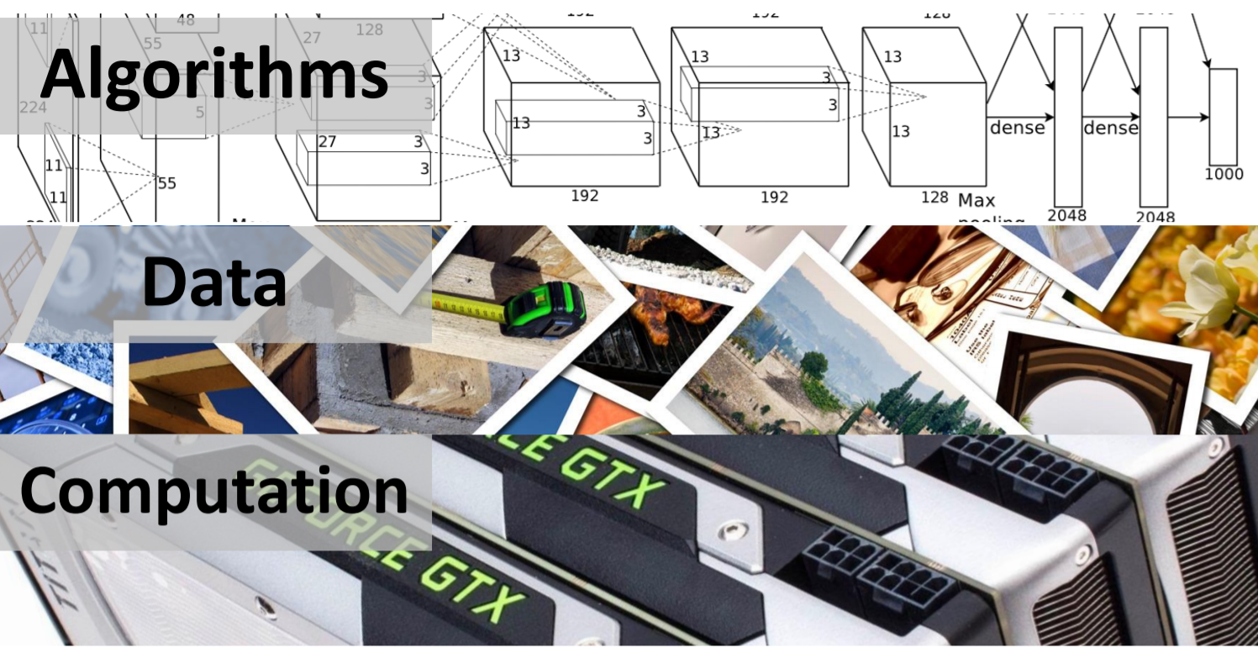
What does a NN needs?

Slide 6
What a neural network can do?
Image based:
Object recognition
Human pose detection
3D reconstruction from a signal image
Image captioning
Style transfer
Non image based:
Language translation
Game playing
And much-much more…

Slide 7
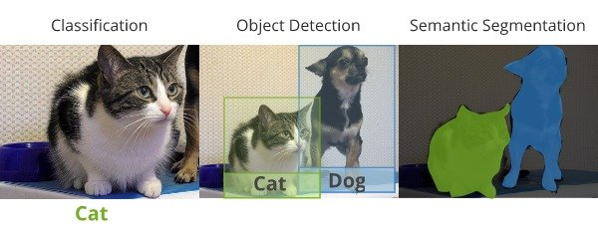
Object recognition

Slide 8

Object recognition

Slide 9
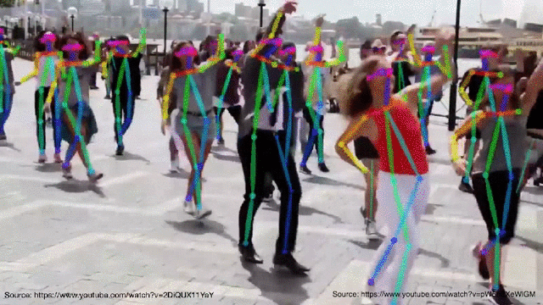
Human pose detection

Slide 10
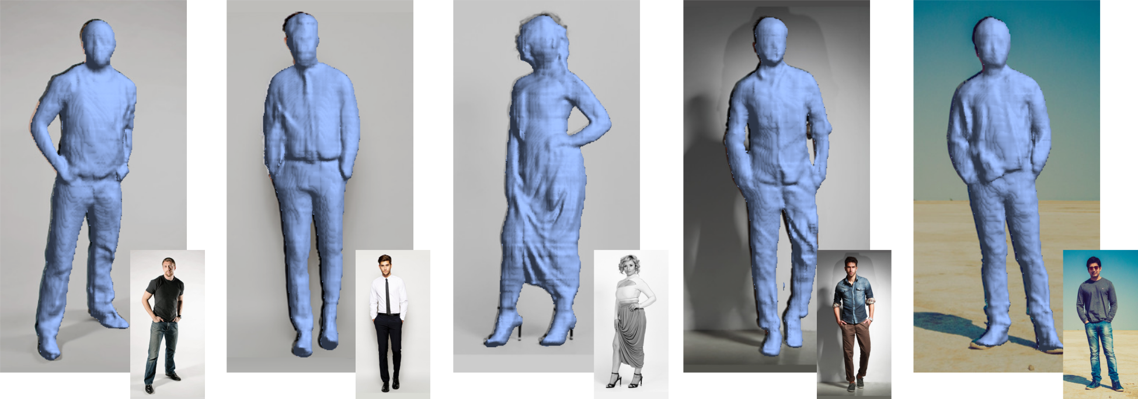
3D reconstruction from a single image

Slide 11
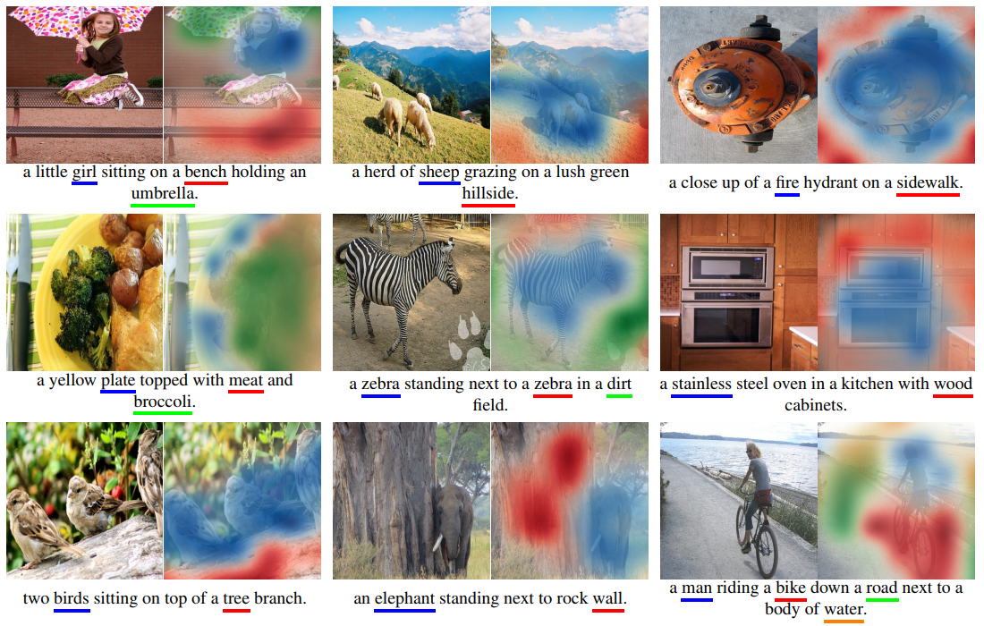
Image captioning

Slide 12
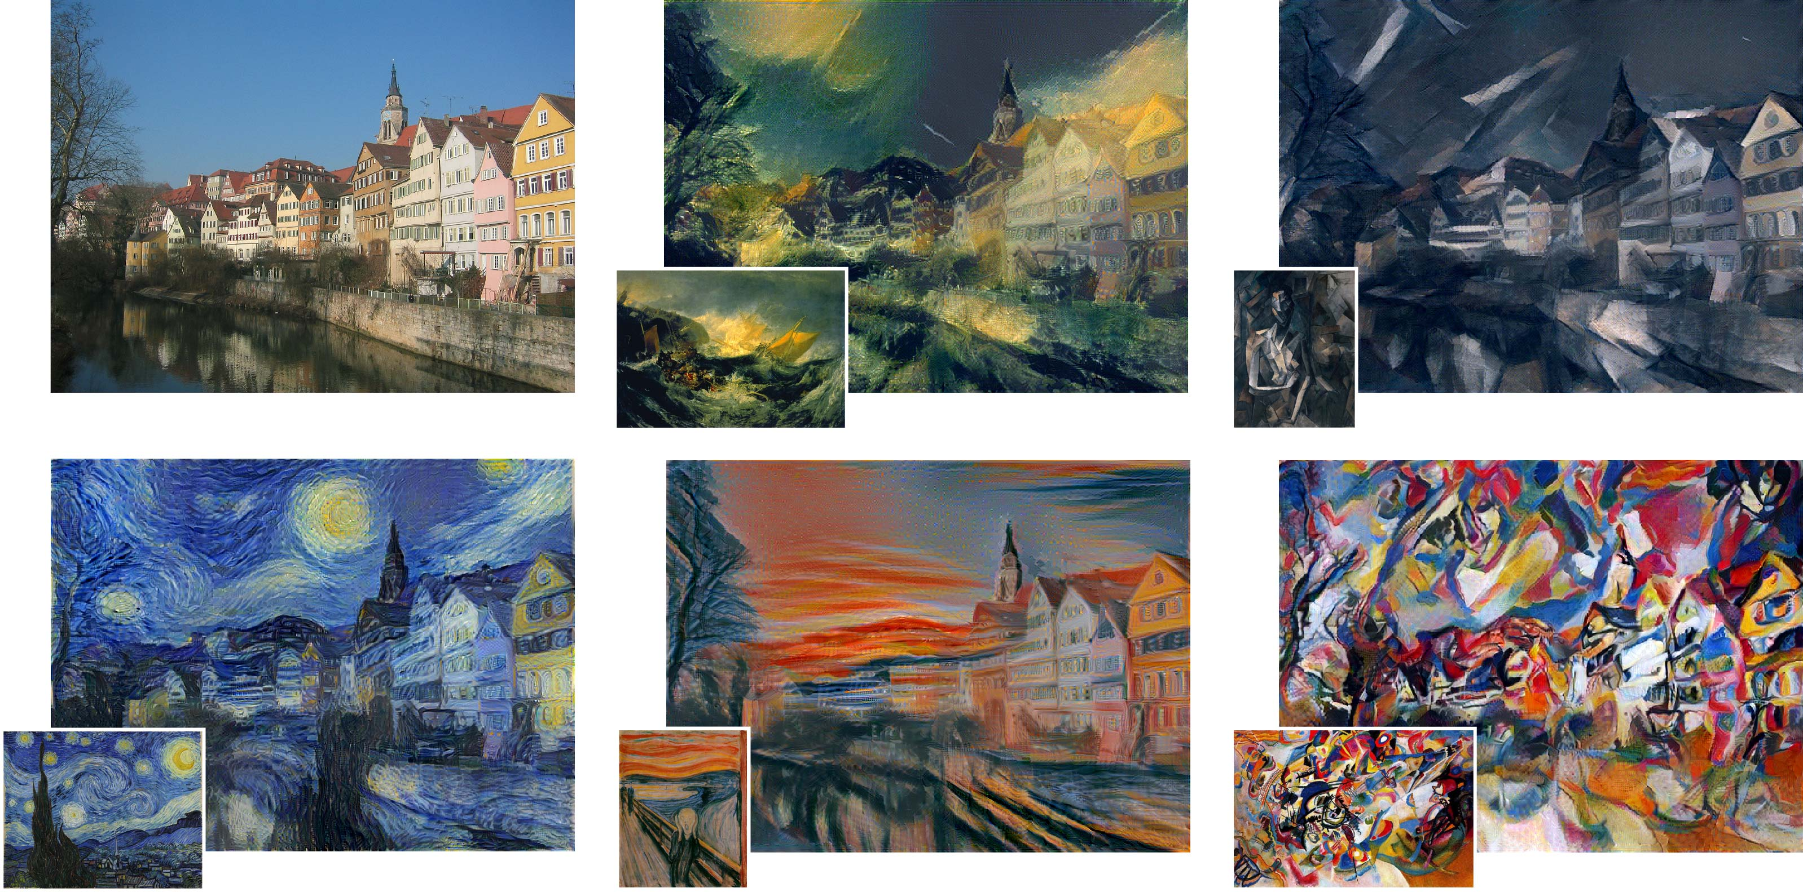
Style transfer

Slide 13
Object recognition challenges
As we’ve seen before- object recognition is hard!

Slide 14
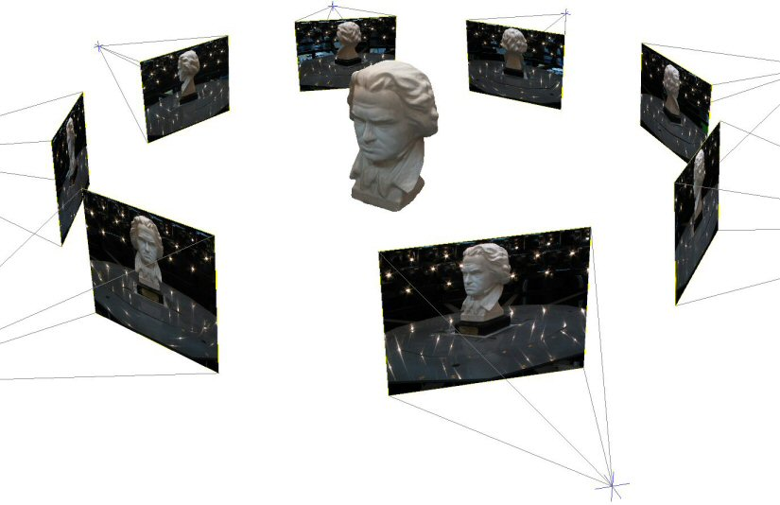
Challenge: variable viewpoint

Slide 15
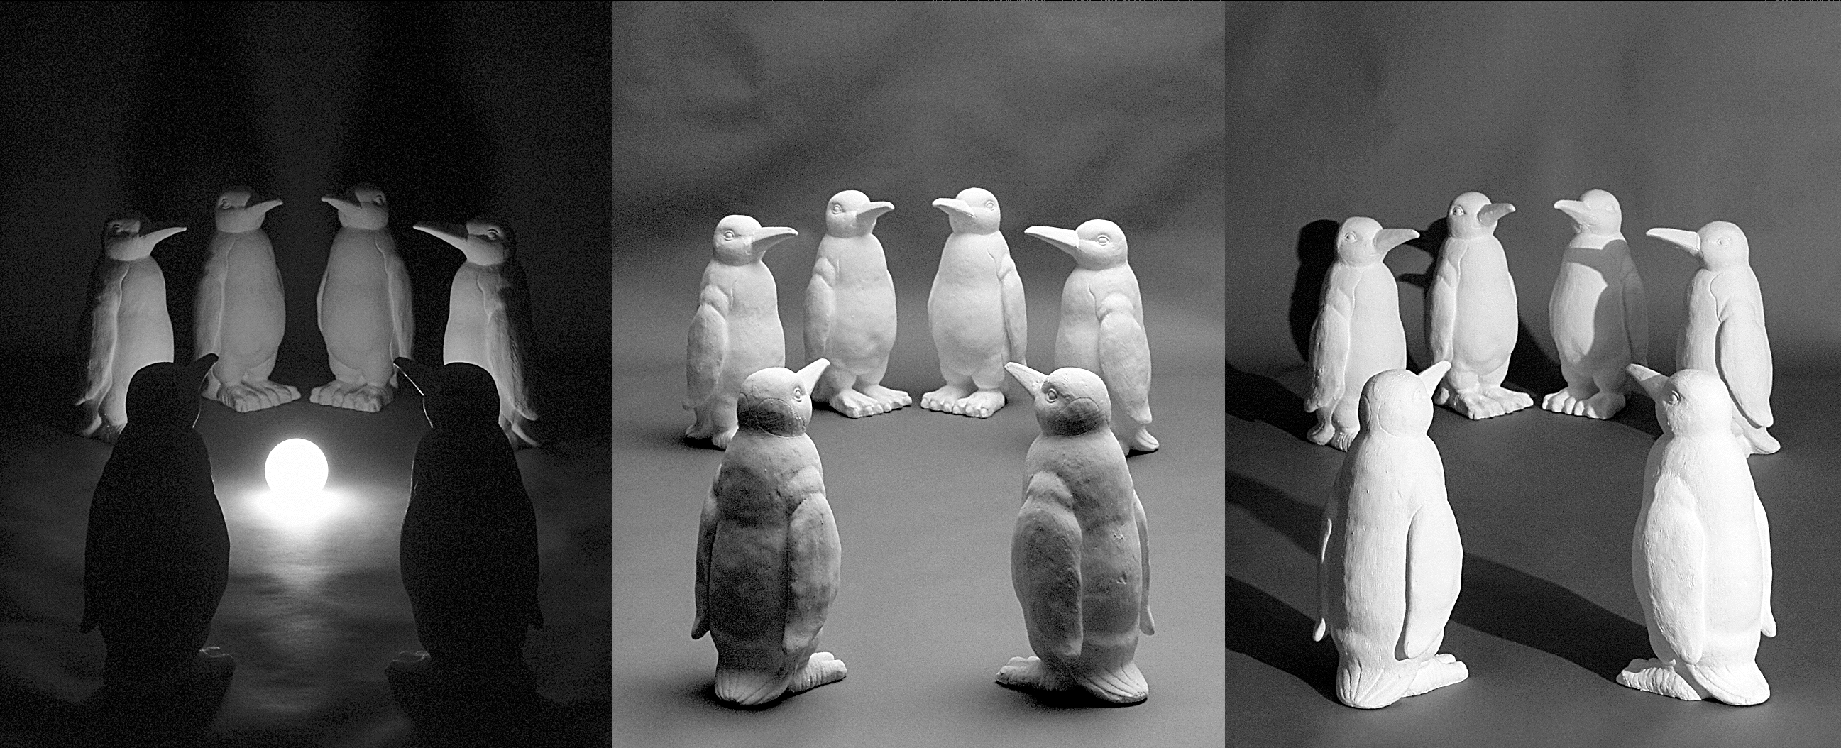
Challenge: variable illumination
image credit: J. Koenderink

Slide 16
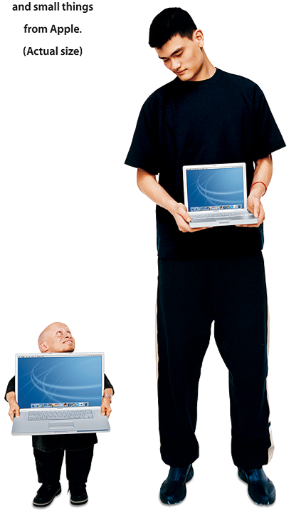
Challenge: scale

Slide 17
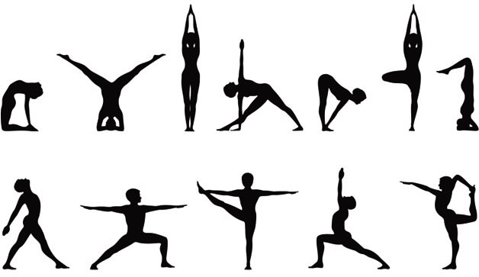
Challenge: deformation

Slide 18
Challenge: occlusion

Slide 19
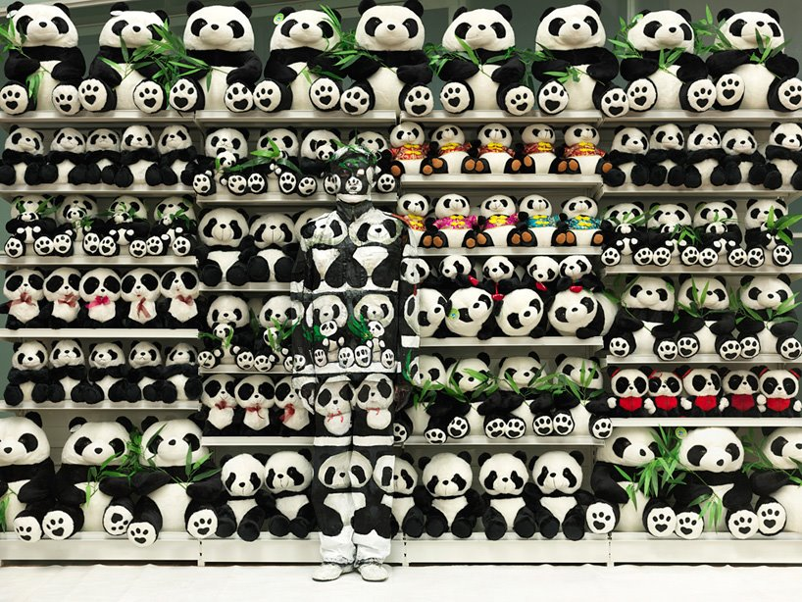
Challenge: background clutter

Slide 20
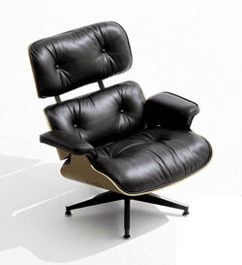
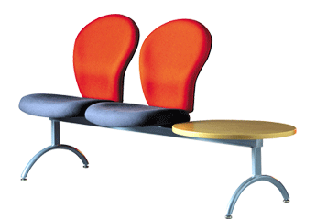
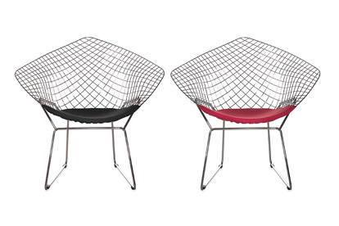
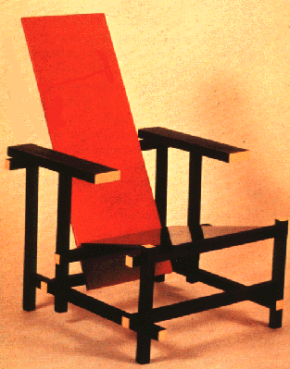
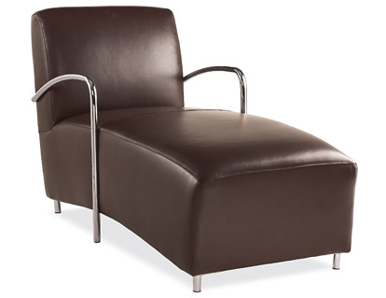
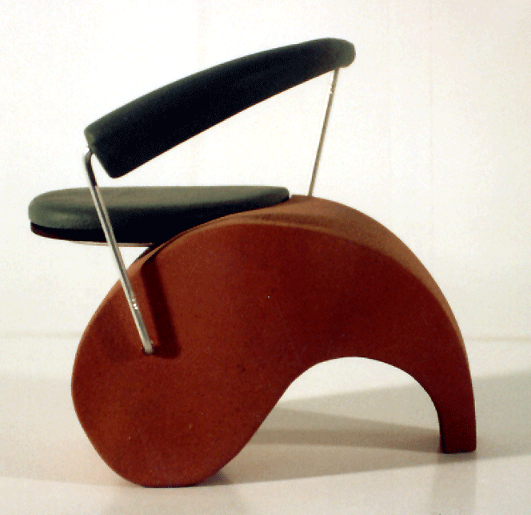
Challenge: intra-class variations
Svetlana Lazebnik

Slide 21
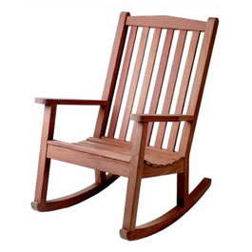
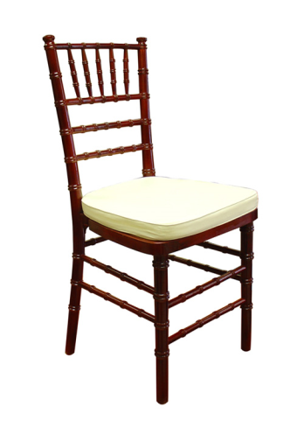
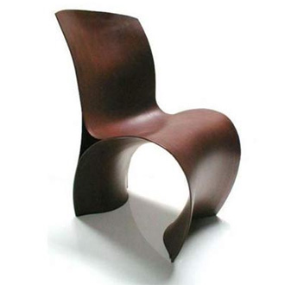
Object recognition challenges
We’ve already seen that this is a hard problem to tackle with “classic” CV algorithms like SIFT and template matching.
Template matching does a relatively good job to find the same template instance in an image.
SIFT can extend this to find the instance with changing viewpoint/scale/illumination and rotation.
What happens when want to find similar object that are not the same?
NN for the saving!

Slide 22
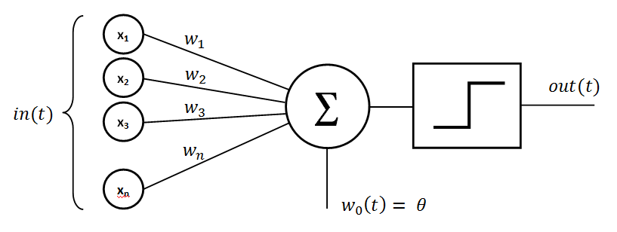
perceptron
The basic building block of all NN.
First introduced in 1958 at Cornell Aeronautical Laboratory by Frank Rosenblatt.
We will talk more about it in a moment…

Slide 23

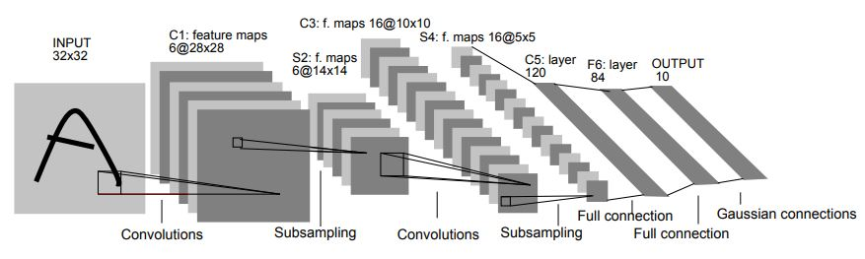
MNIST + LeNet-5
MNIST is a large dataset of handwritten digits used in training of LeNet-5.
LeNet-5 is the first known NN to solve a major computer vision problem:
Classifies digits, was applied by several banks to recognize hand-written numbers on checks.
Used 7 trainable layers with a total of 60K params (sounds a lot?).
Yann LeCun at el., 1998, 23000 citations.

Slide 24
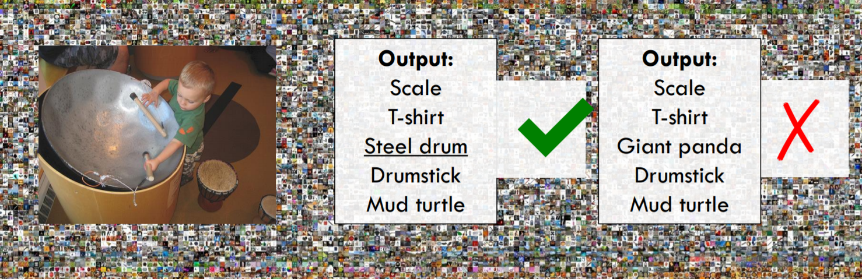
Large Scale Visual Recognition Challenge (ILSVRC)
ImageNet is an image database most known for its ILSVRC challenge, and specifically for the image classification contest:
1000 object classes
1,431,167 images
Winner has the minimum mean labeling error out of 5 gausses for a given unknown test set.

Slide 25
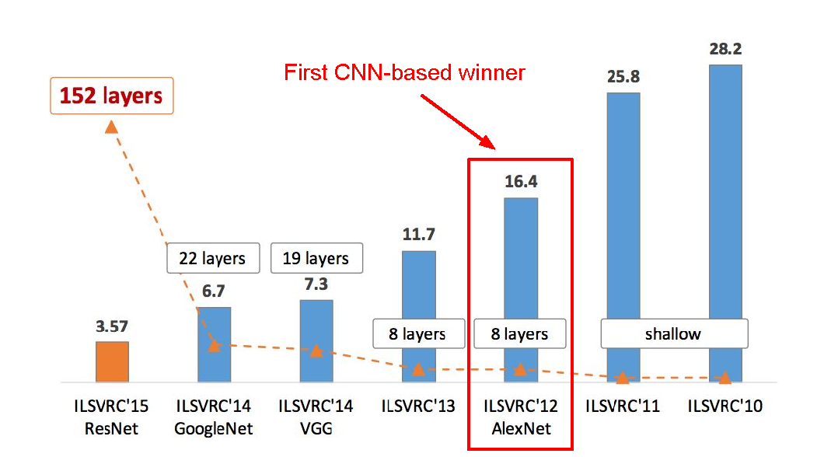
ILSVRC winners
Human error: 5%

Slide 26
perceptron

Slide 27
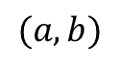
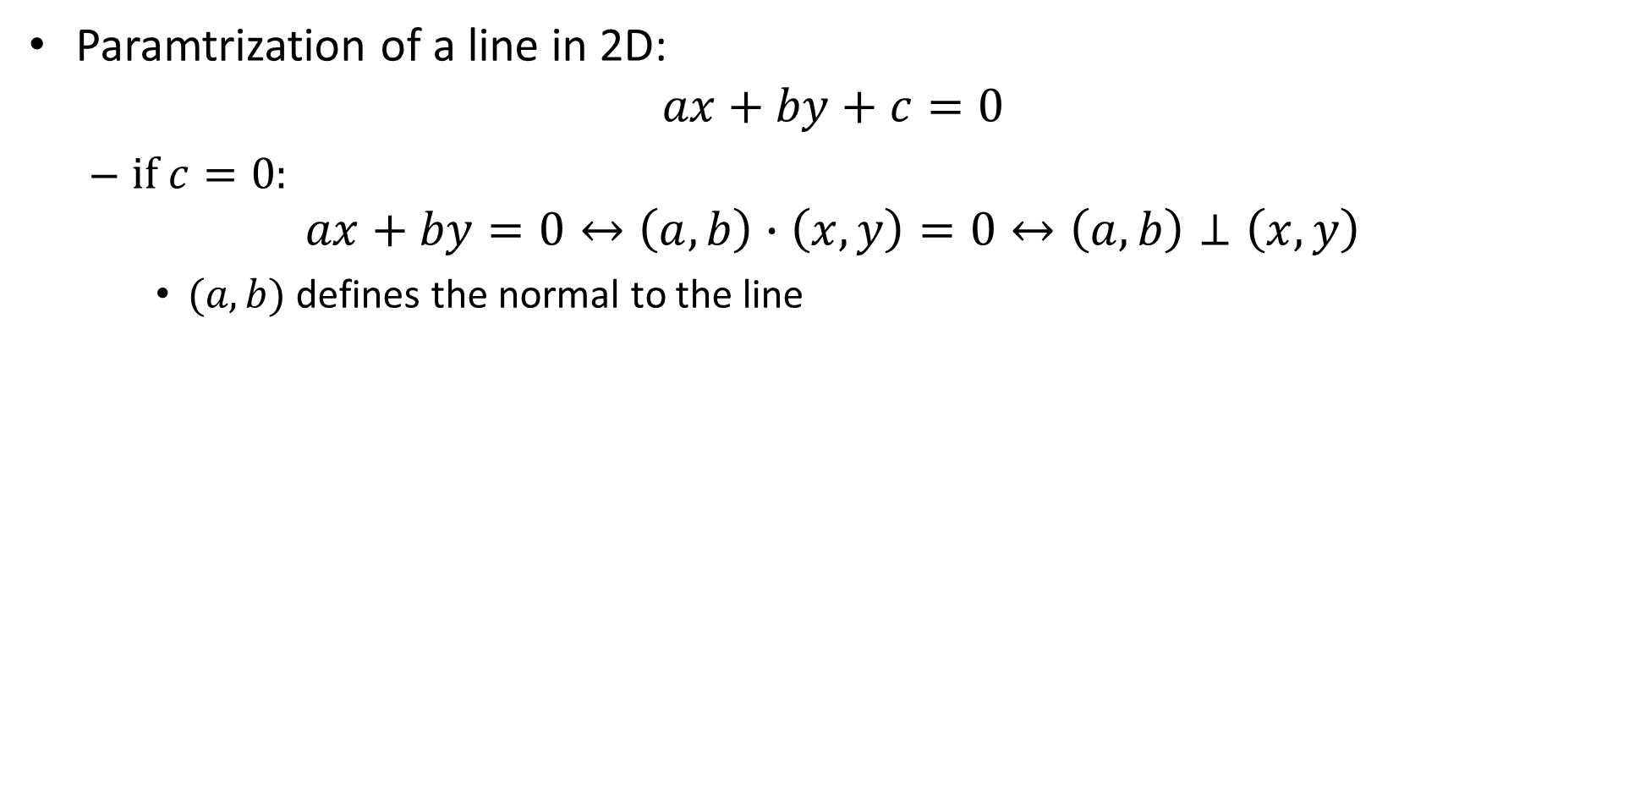
hyperplane
Paramtrization of a line in 2D:
$$ax+by+c=0$$
if $c=0$:
$$ax+by=0↔\left(a,b\right)∙\left(x,y\right)=0↔\left(a,b\right)⊥\left(x,y\right)$$
$(a,b)$ defines the normal to the line
$$(a,b)$$

Slide 28
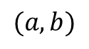
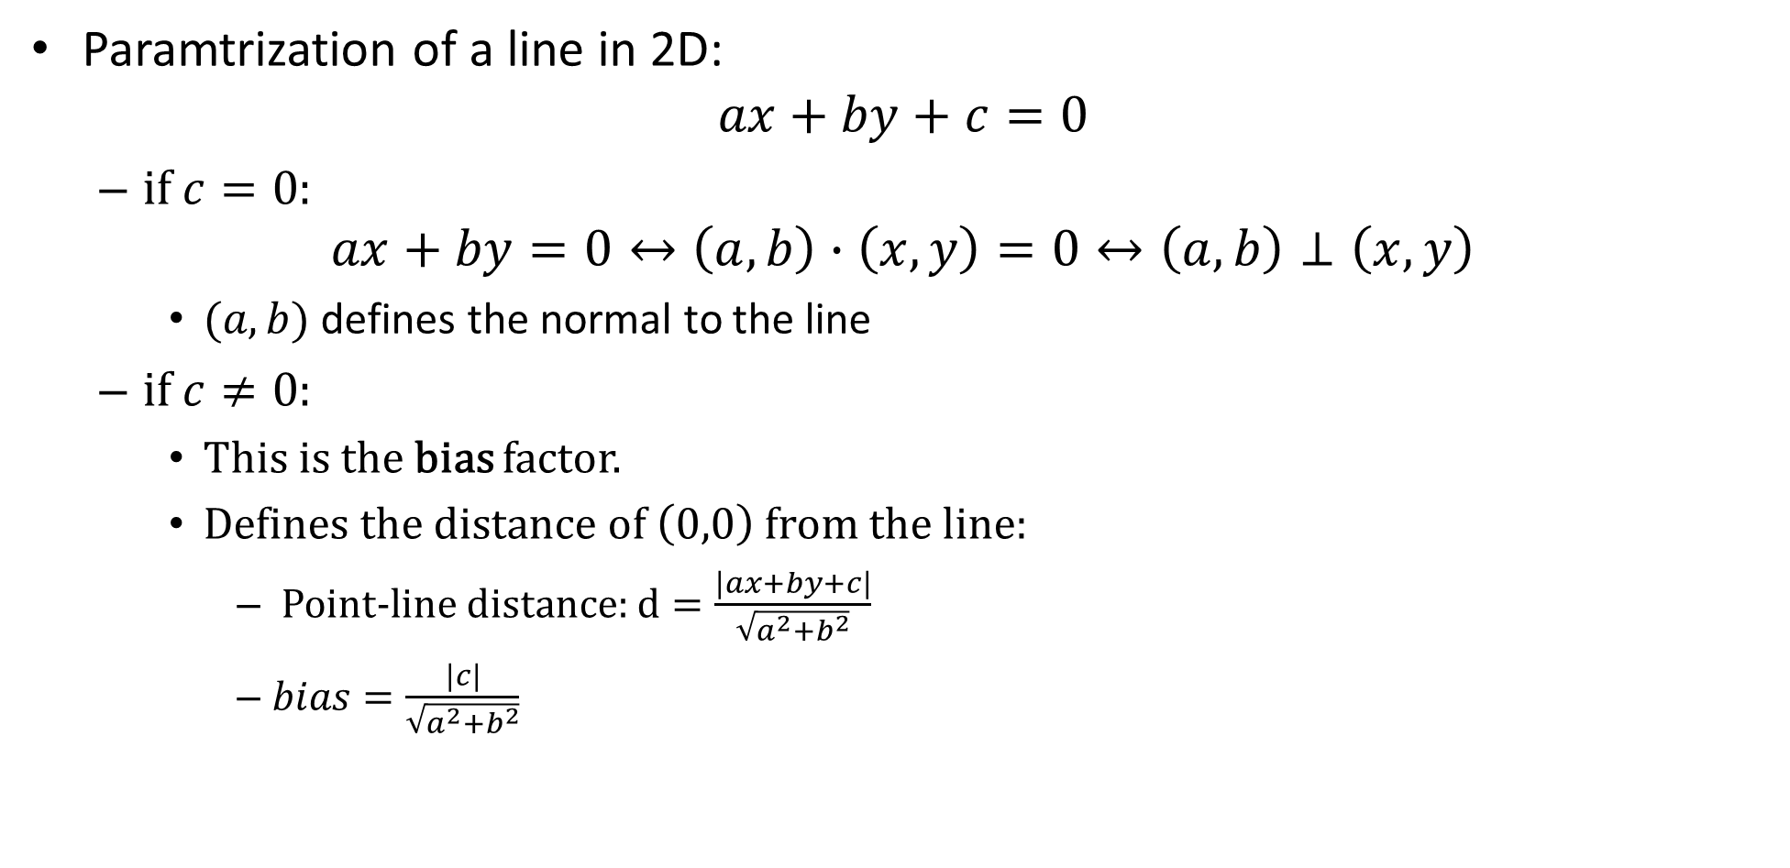
hyperplane
Paramtrization of a line in 2D:
$$ax+by+c=0$$
if $c=0$:
$$ax+by=0↔\left(a,b\right)∙\left(x,y\right)=0↔\left(a,b\right)⊥\left(x,y\right)$$
$(a,b)$ defines the normal to the line
if $c≠0$:
This is the bias factor.
Defines the distance of $\left(0,0\right)$ from the line:
Point-line distance: $d=\frac{\left|ax+by+c\right|}{\sqrt{a^{2}+b^{2}}}$
$bias=\frac{\left|c\right|}{\sqrt{a^{2}+b^{2}}}$
$$(a,b)$$

Slide 29
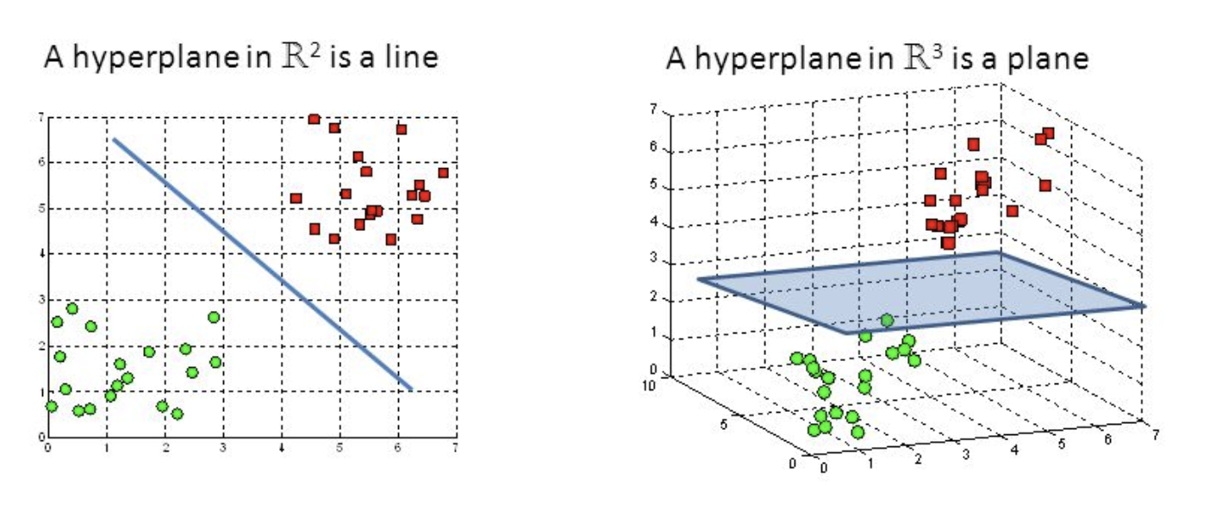
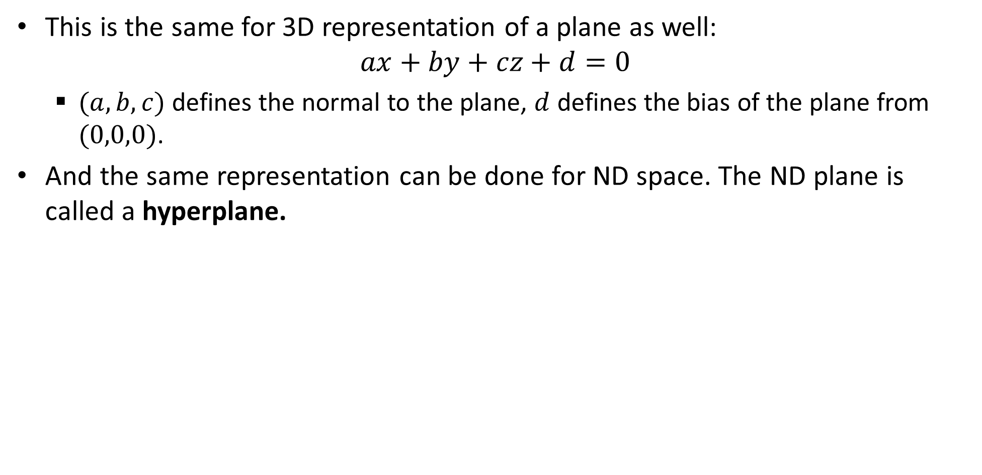
hyperplane
This is the same for 3D representation of a plane as well:
$$ax+by+cz+d=0$$
$(a,b,c)$ defines the normal to the plane, $d$ defines the bias of the plane from $(0,0,0)$.
And the same representation can be done for ND space. The ND plane is called a hyperplane.

Slide 30
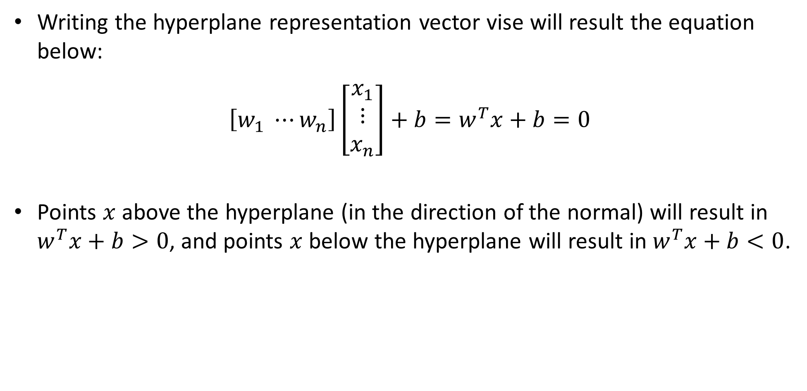
hyperplane
Writing the hyperplane representation vector vise will result the equation below:
$\left[w_{1} ⋯w_{n}\right]\left[\begin{aligned}x_{1} \\ ⋮ \\ x_{n}\end{aligned}\right]+b=w^{T}x+b=0$
Points $x$ above the hyperplane (in the direction of the normal) will result in $w^{T}x+b>0$, and points $x$ below the hyperplane will result in $w^{T}x+b<0$.

Slide 31
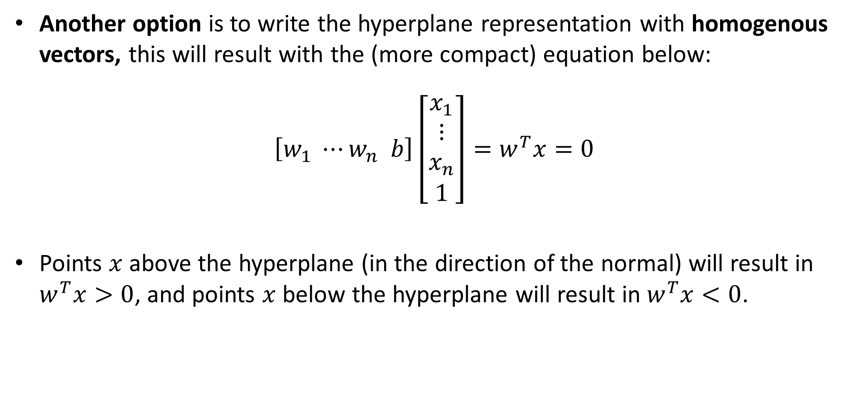
hyperplane
Another option is to write the hyperplane representation with homogenous vectors, this will result with the (more compact) equation below:
$\left[w_{1} ⋯w_{n} b\right]\left[\begin{aligned}x_{1} \\ ⋮ \\ x_{n} \\ 1\end{aligned}\right]=w^{T}x=0$
Points $x$ above the hyperplane (in the direction of the normal) will result in $w^{T}x>0$, and points $x$ below the hyperplane will result in $w^{T}x<0$.

Slide 32
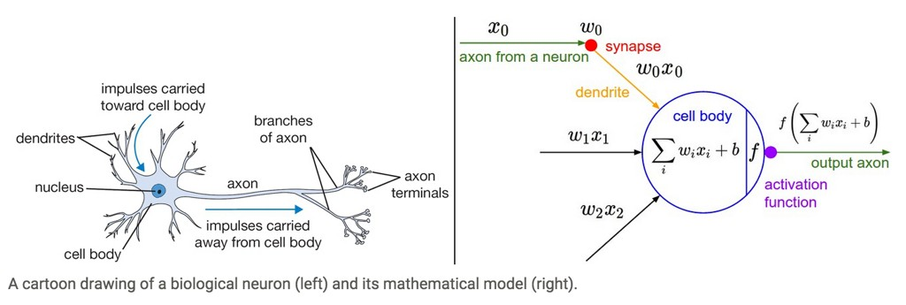
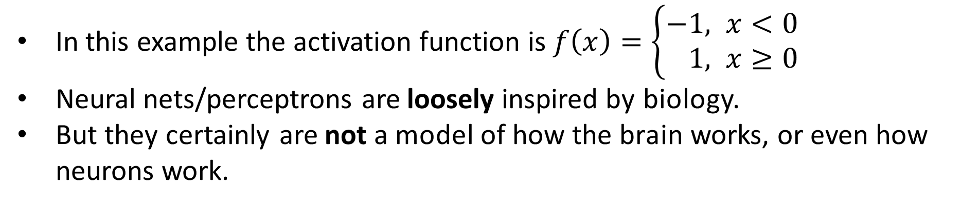
Side note: Inspiration from Biology
In this example the activation function is $f\left(x\right)=\left\{\begin{aligned}−&1, x<0 \\ &1, x≥0\end{aligned}\right.$
Neural nets/perceptrons are loosely inspired by biology.
But they certainly are not a model of how the brain works, or even how neurons work.

Slide 33
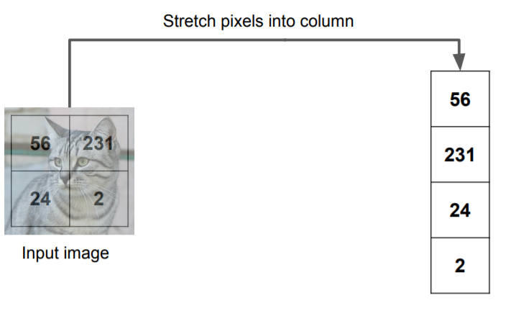
Hyperplanes and image classification
Let’s say an image is a vector in 4D.

Slide 34
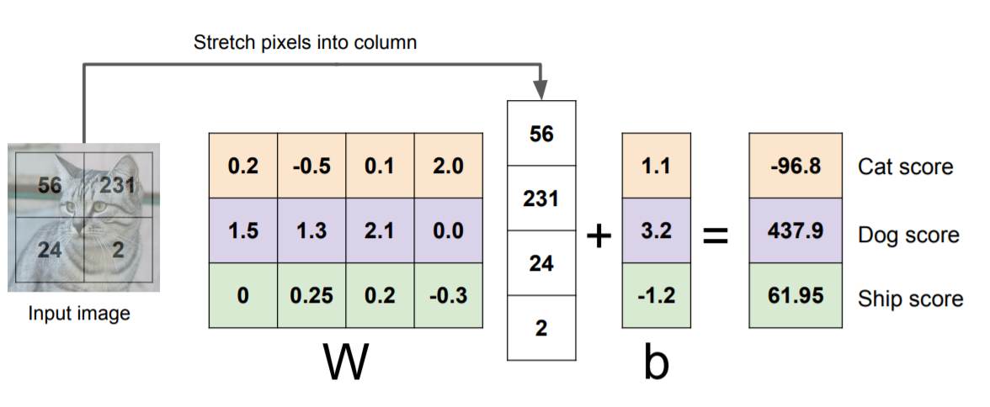
Hyperplanes and image classification
We want to find a hyperplane in 4D space that puts all cats’ vectors in one side of it, and all other images in the other side.
Let’s assume there are 2 more classes. In total: cats, dogs and ships.
Find 3 separating planes, one for each class.

Slide 35
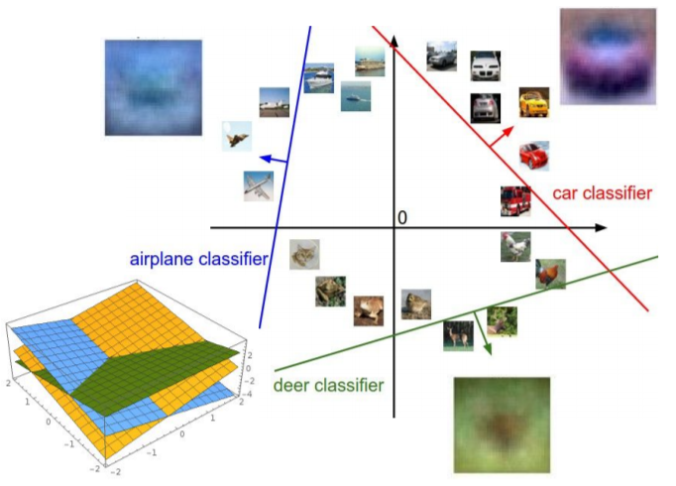
Hyperplanes and image classification
Another example.

Slide 36
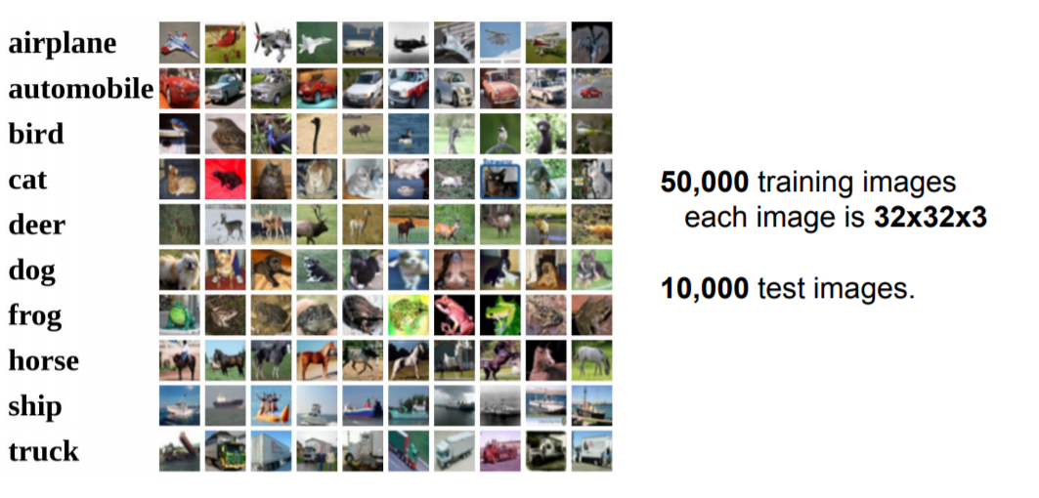
CIFAR10 dataset
32X32X3=3072 DOFs in this problem, and images vary a lot. This is not possible to linearly separate.

Slide 37
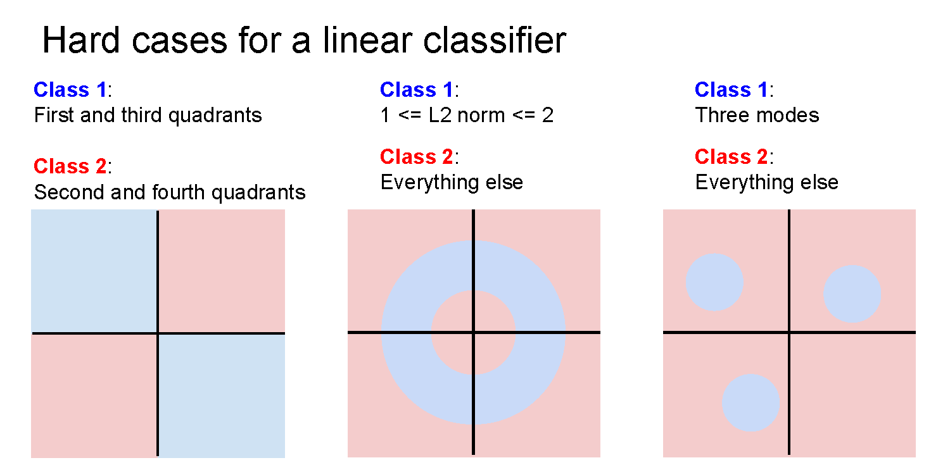
More none linear separable examples

